Slide 1
Ascend Tech Workshop Final Presentation
Team B

Slide 2

Project Introduction
Learned Python basics throughout Tech Workshop
Using Python to create a model to analyze data and create a prediction
Using charts and graphs to describe data
Determining how likely it is for Ascend members to get Monkey Pox

Slide 3
Agenda
01. Project Introduction
02. Variable
03. Data Visualization
04. Data Cleansing
05. Correlation Plot
06. Logistic Regression

Slide 4
02. Variable

Slide 5
Variable List
Categorical Variables
Unused Variables
1
Rectal Pain
Systemic illness
2
Sore Throat
3
Penile Oedema
4 Values contained
4
Oral Lesions
5
Solitary Lesion
6
Swollen Tonsils
7
HIV infection
8
Sexually Transmitted Diesease

Slide 6
03. Data
Visualization

Slide 7
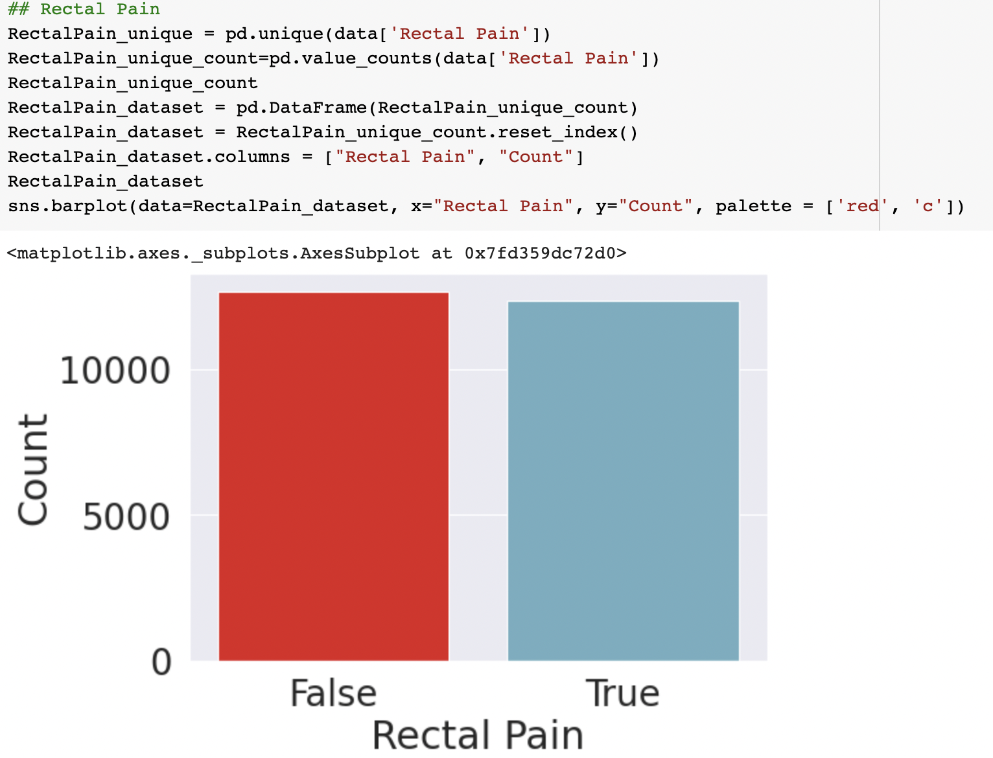
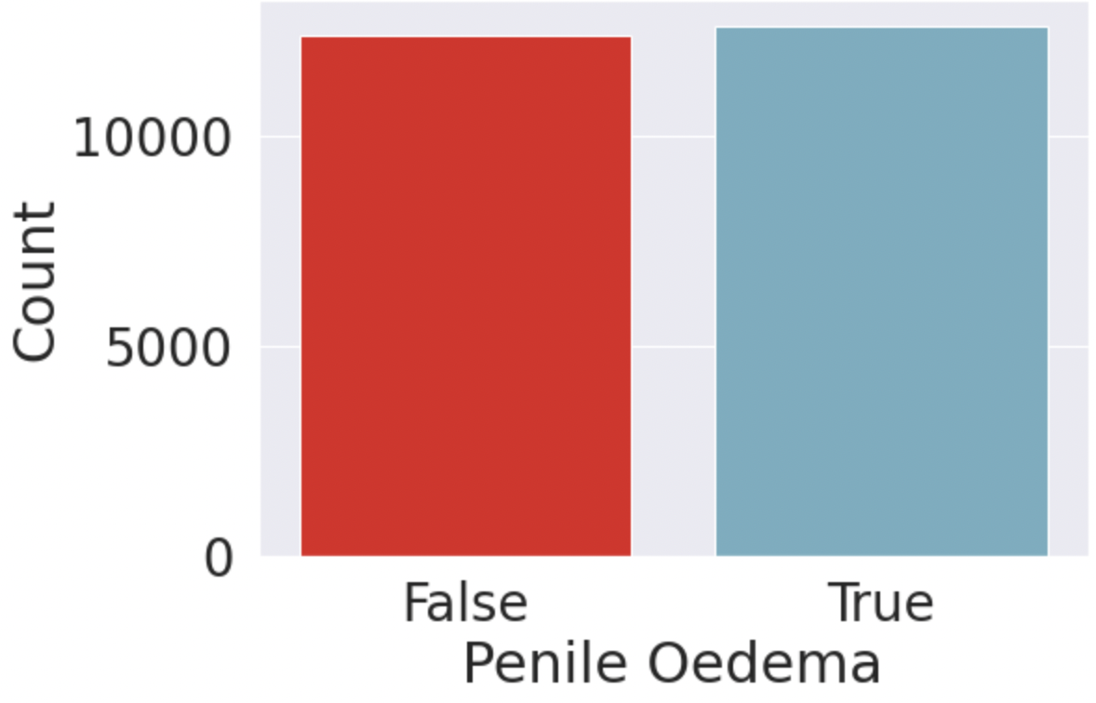
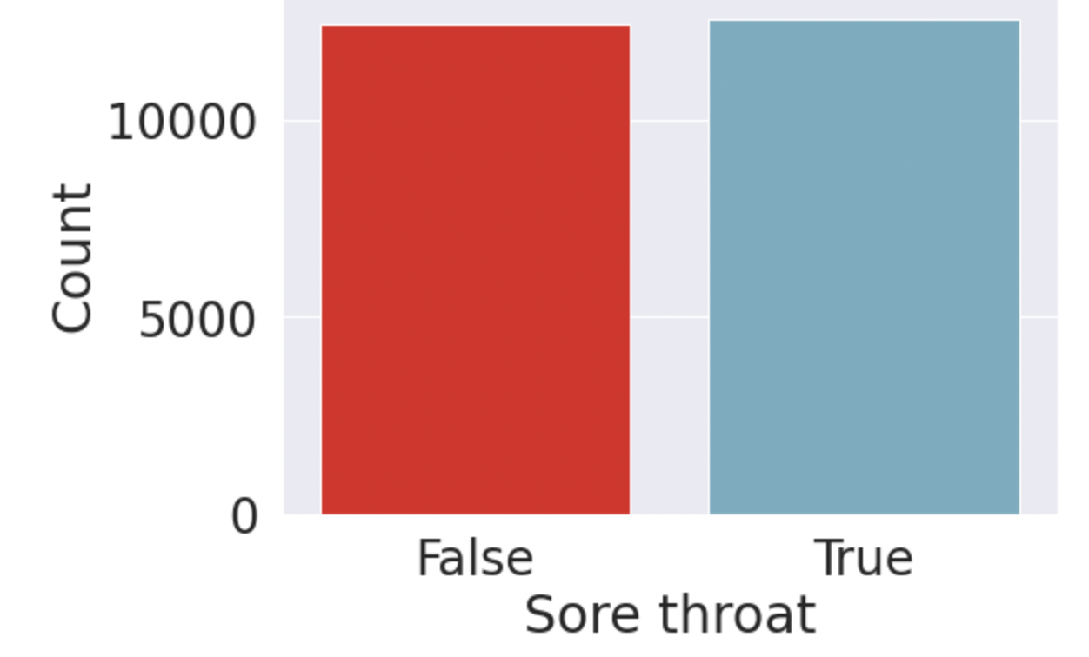
Vertical Bar Plot

Slide 8
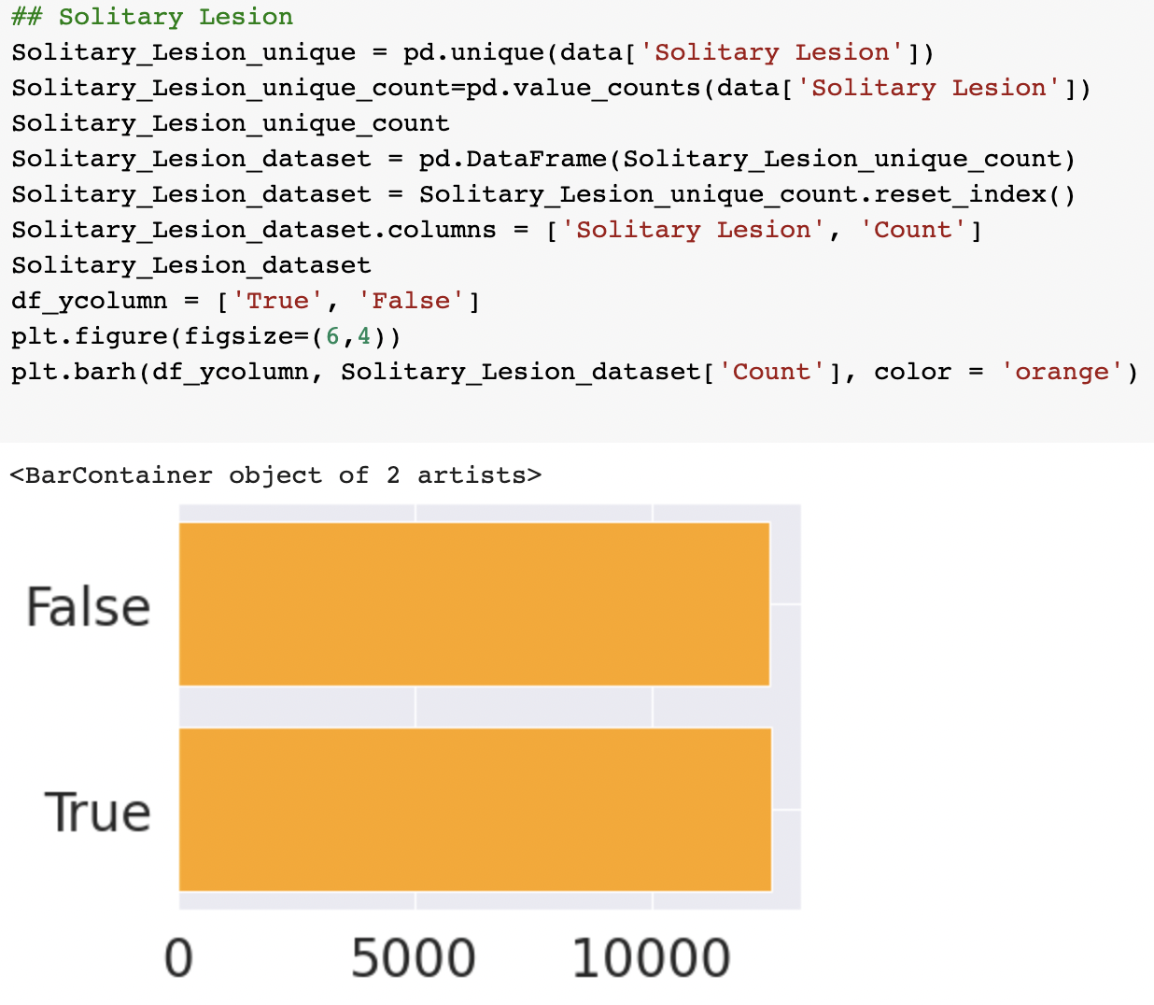
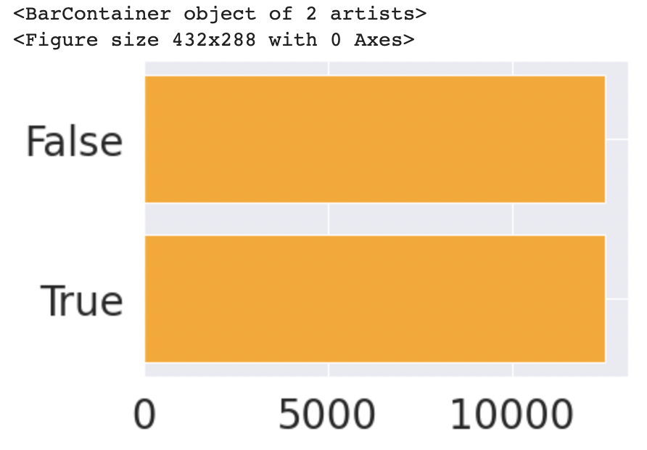
Horizontal Bar Plot

Slide 9
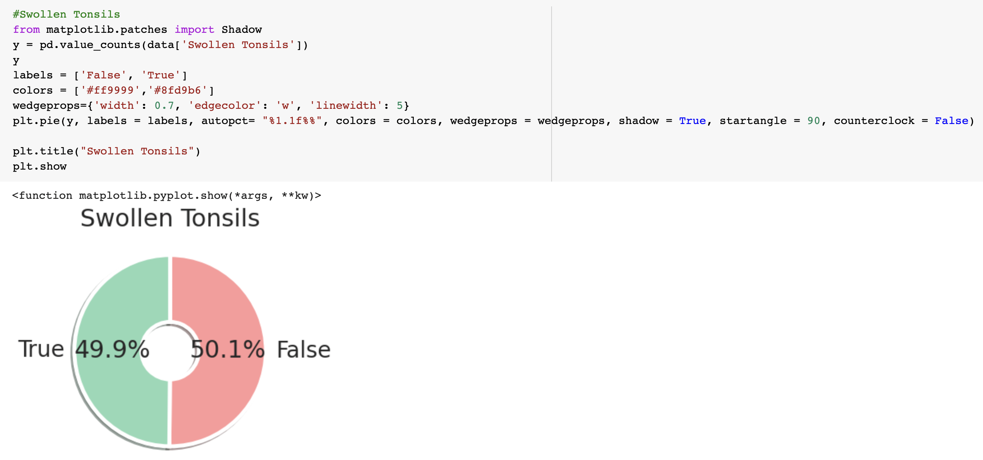
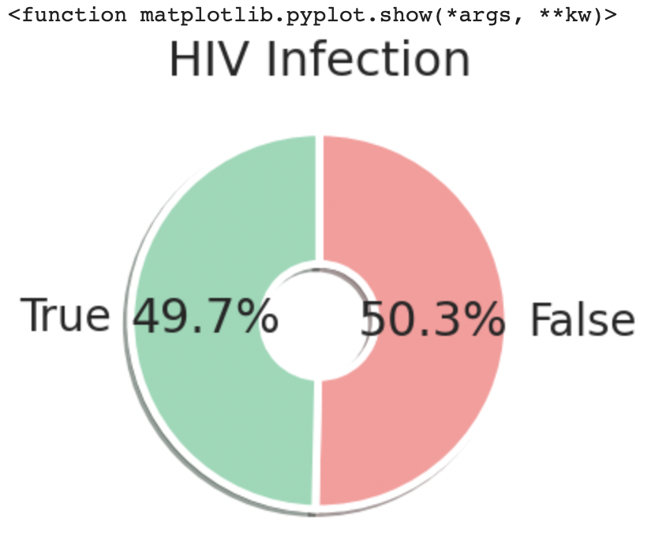
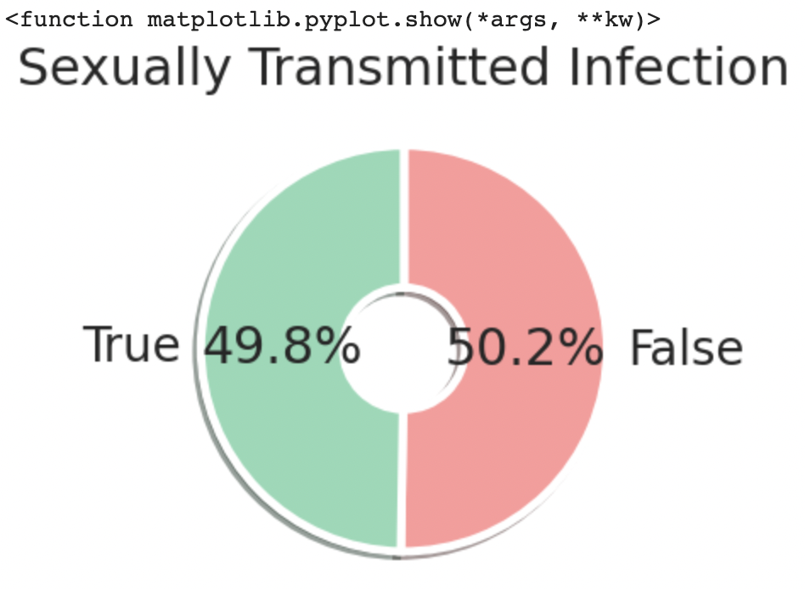
Pie Chart

Slide 10
04. Data
Cleansing

Slide 11
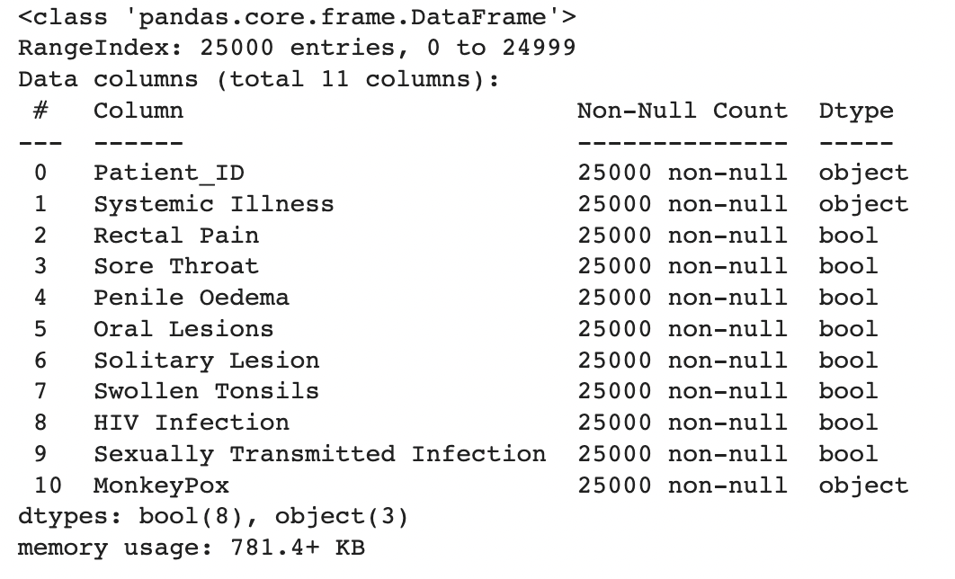
Information of Train Set
Diseases

Slide 12
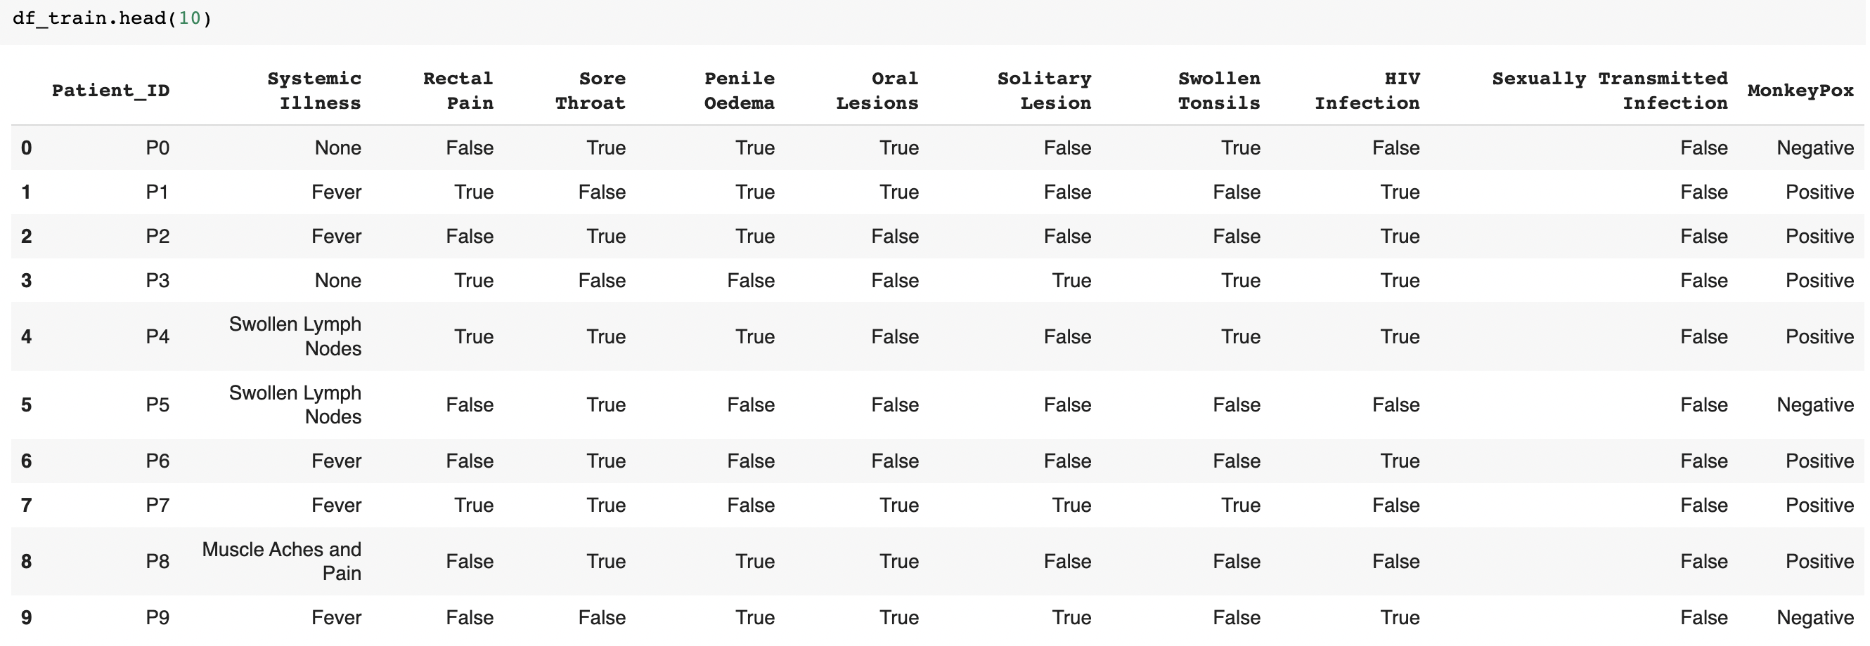
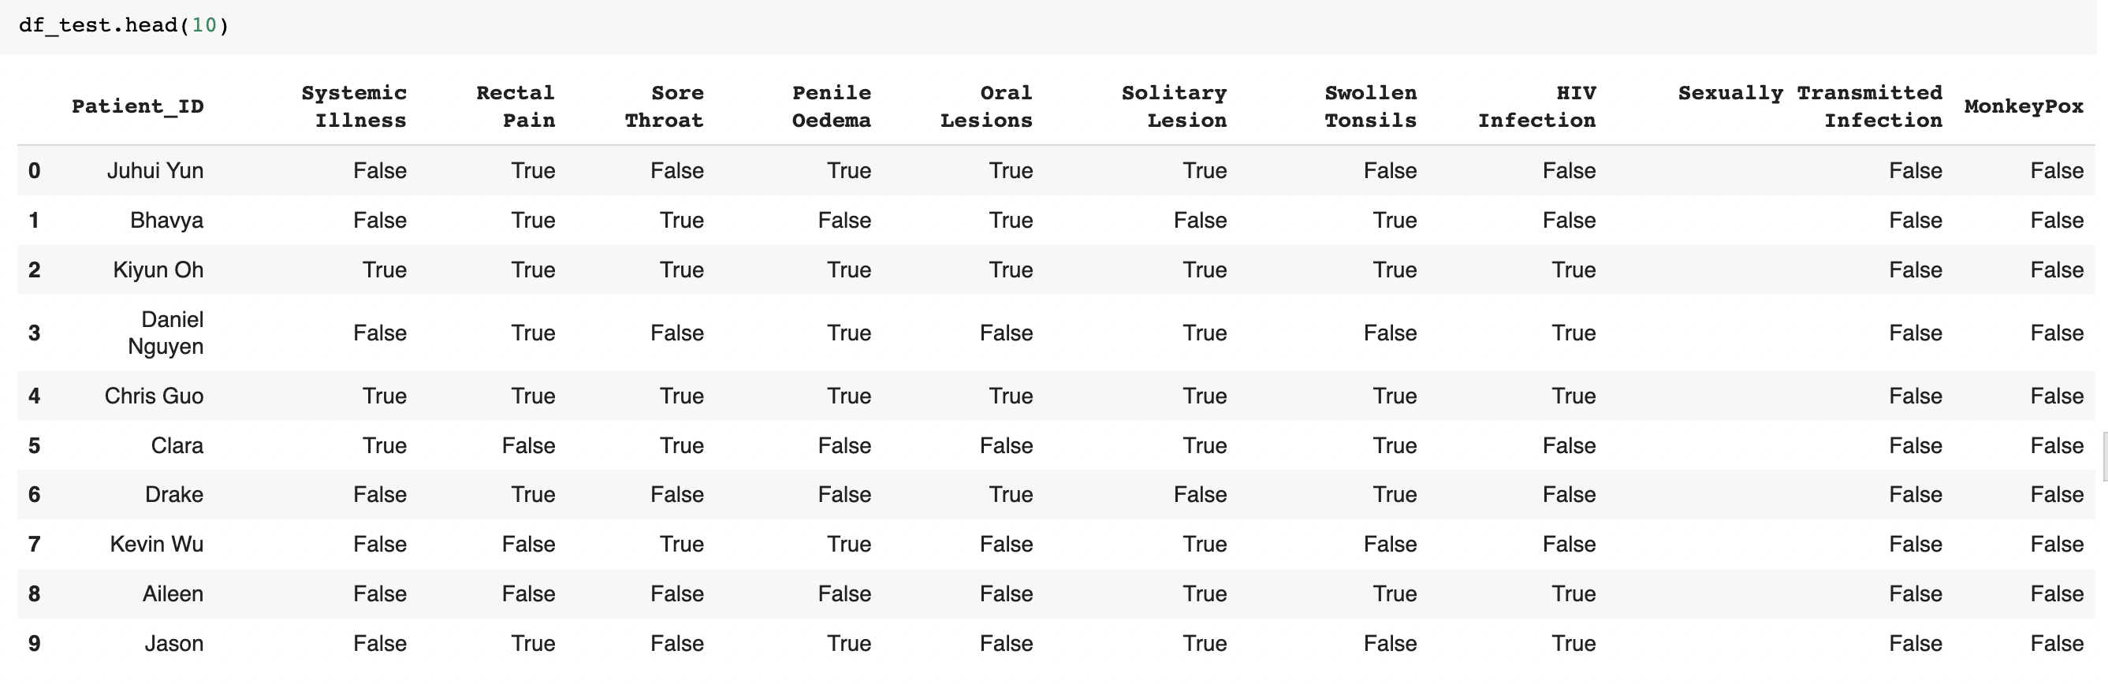
Information of Train Set
Train Set
25000
df_train.head (10)
Test Set
16
df_test.head (10)

Slide 13
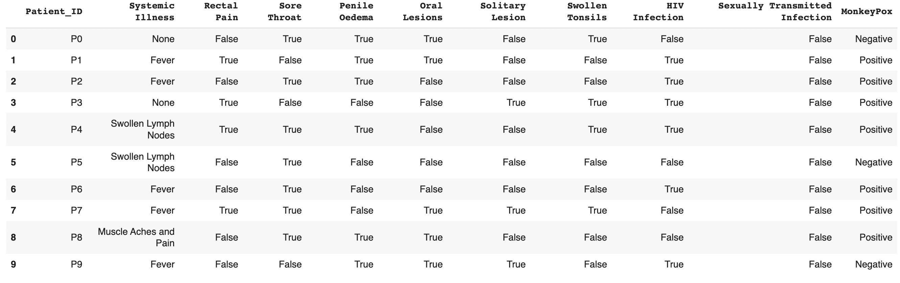
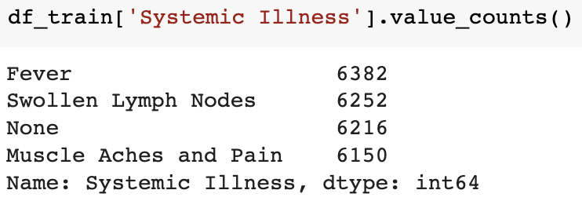
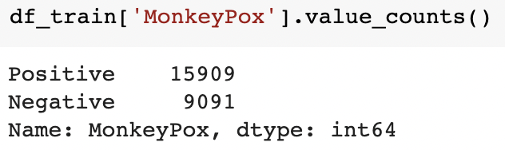
Data Cleansing> Column
Delete
Move to first column
-> reason eliminating

Slide 14
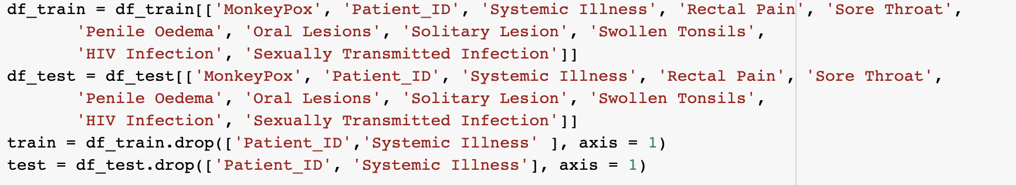
Data Cleansing> Column
Column sequence conversion
Column Delete

Slide 15
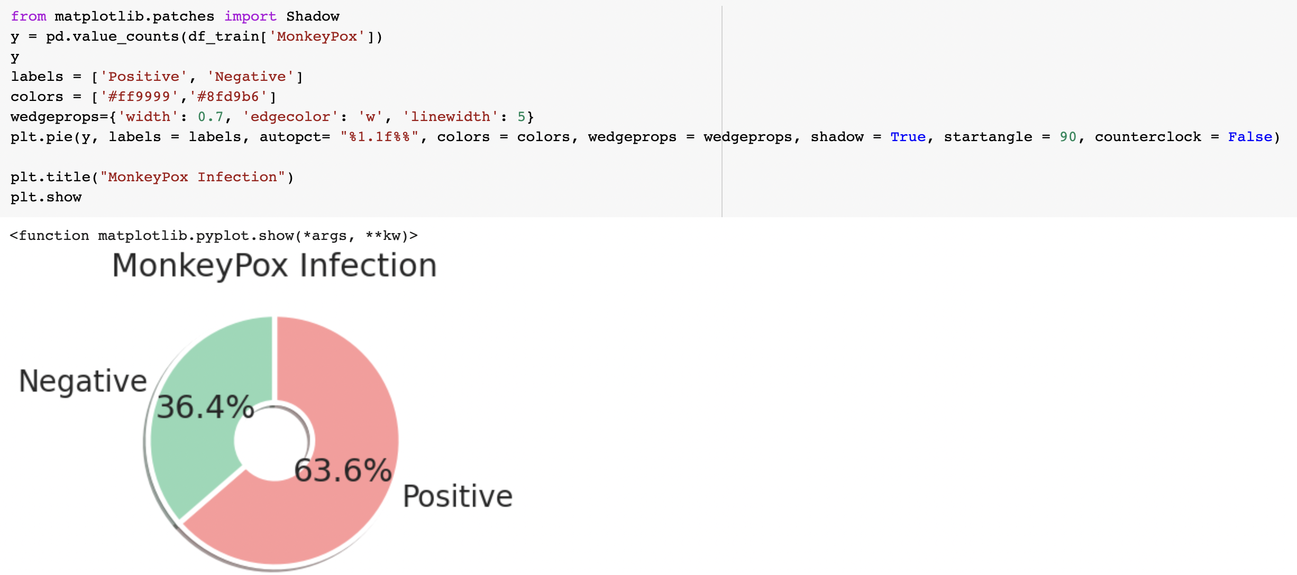
Train Set > Monkey Pox

Slide 16
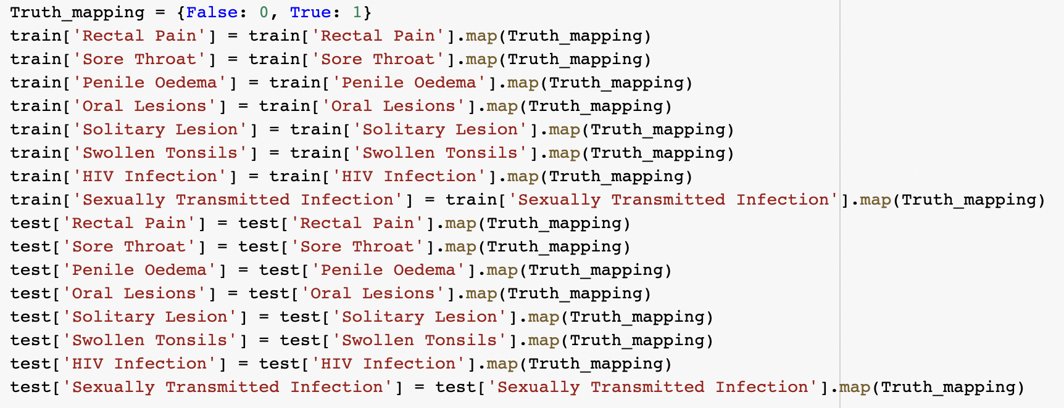
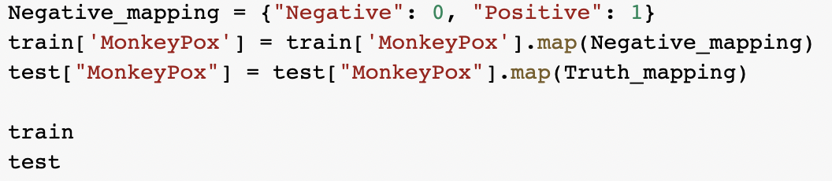
Mapping
Categorical Variable
{False: 0, True : 1}
Monkey Pox
{”Negative”:0, “Postive”:1}

Slide 17
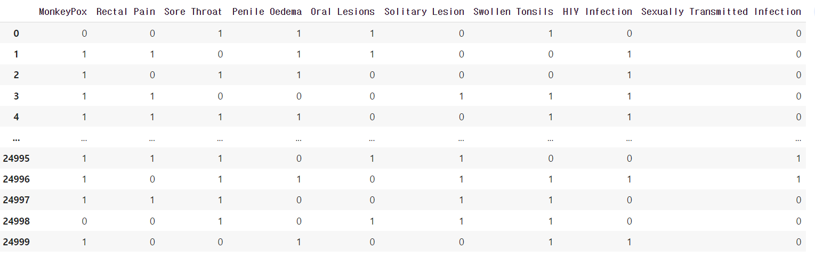
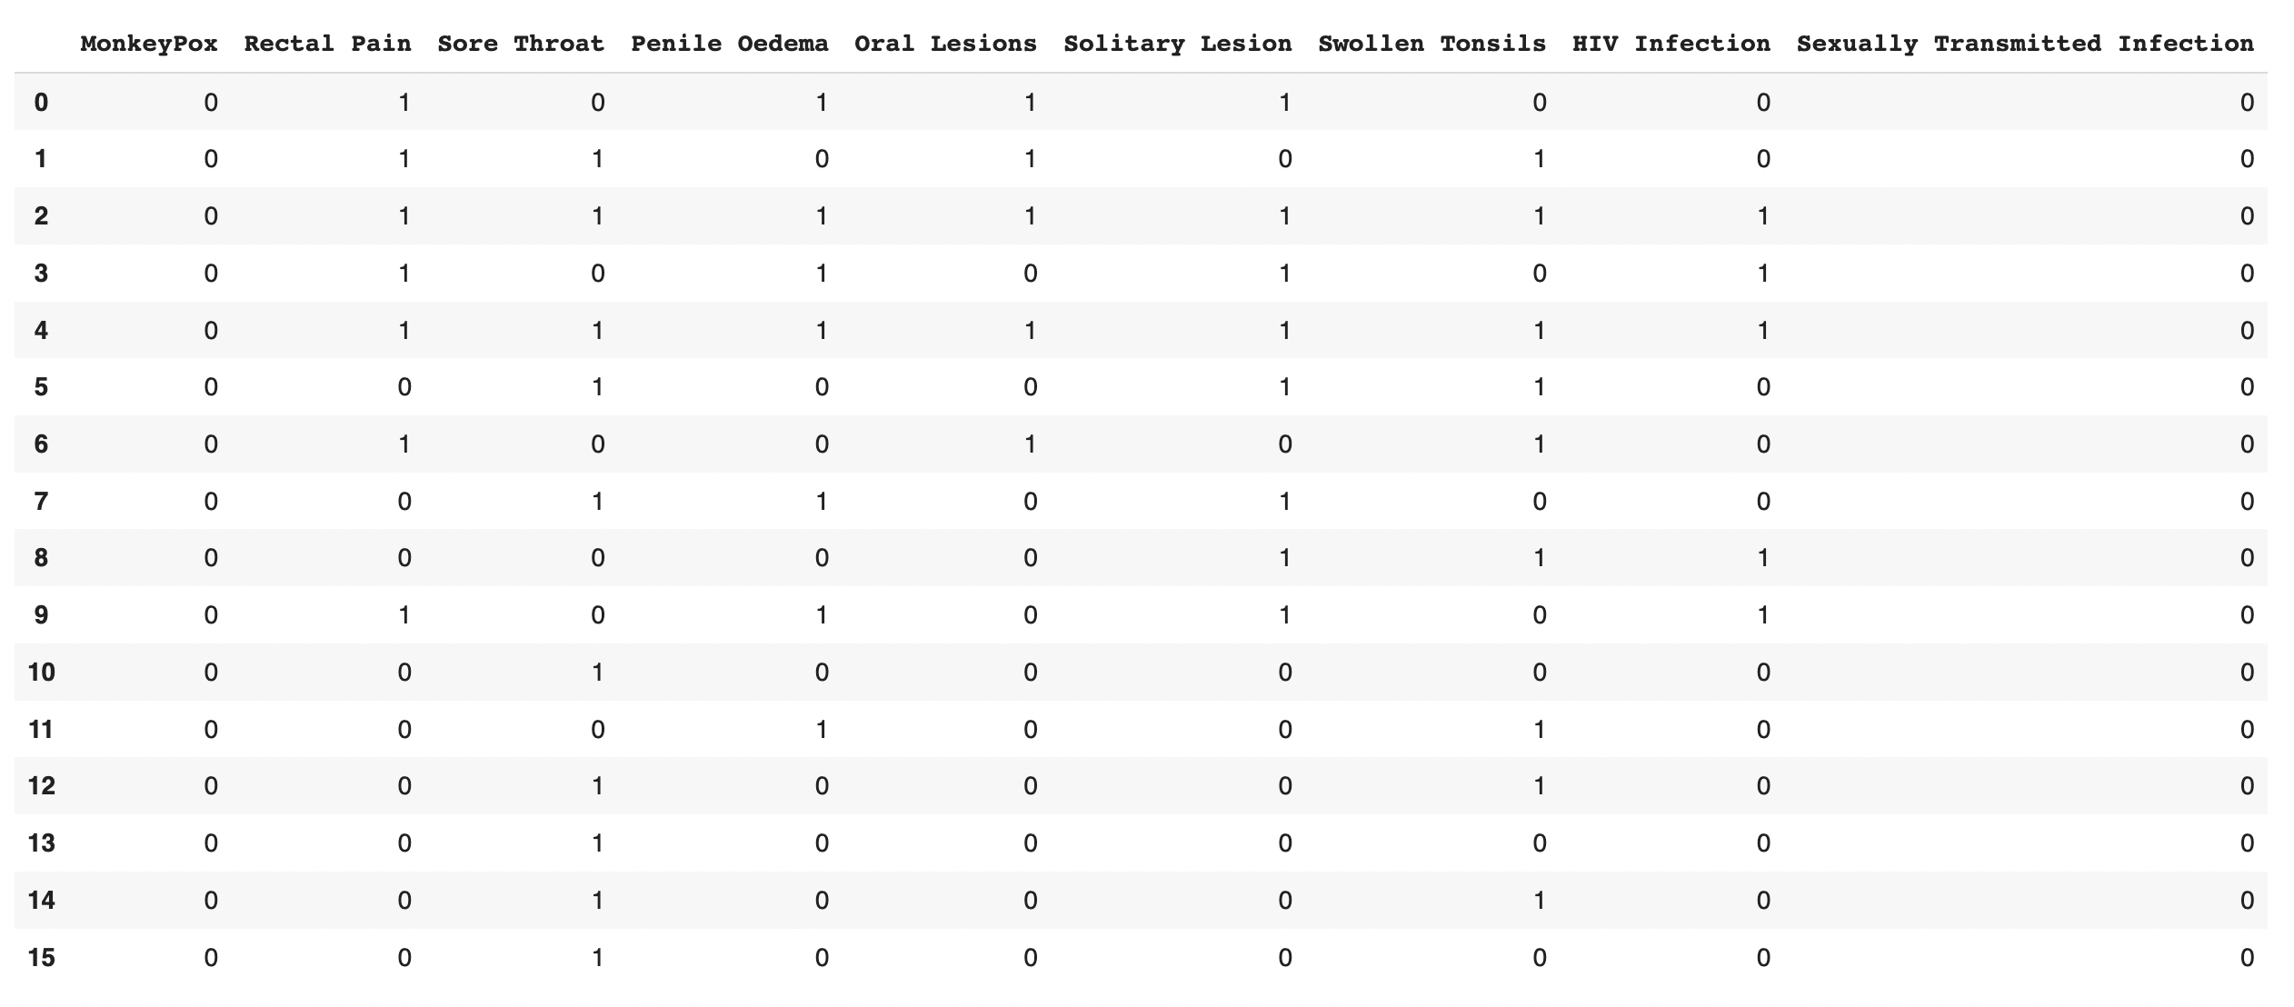
Mapping Result
Train Set
25000
Test Set
16

Slide 18
05. Correlation
Plot

Slide 19
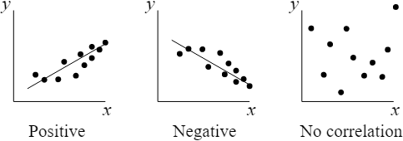
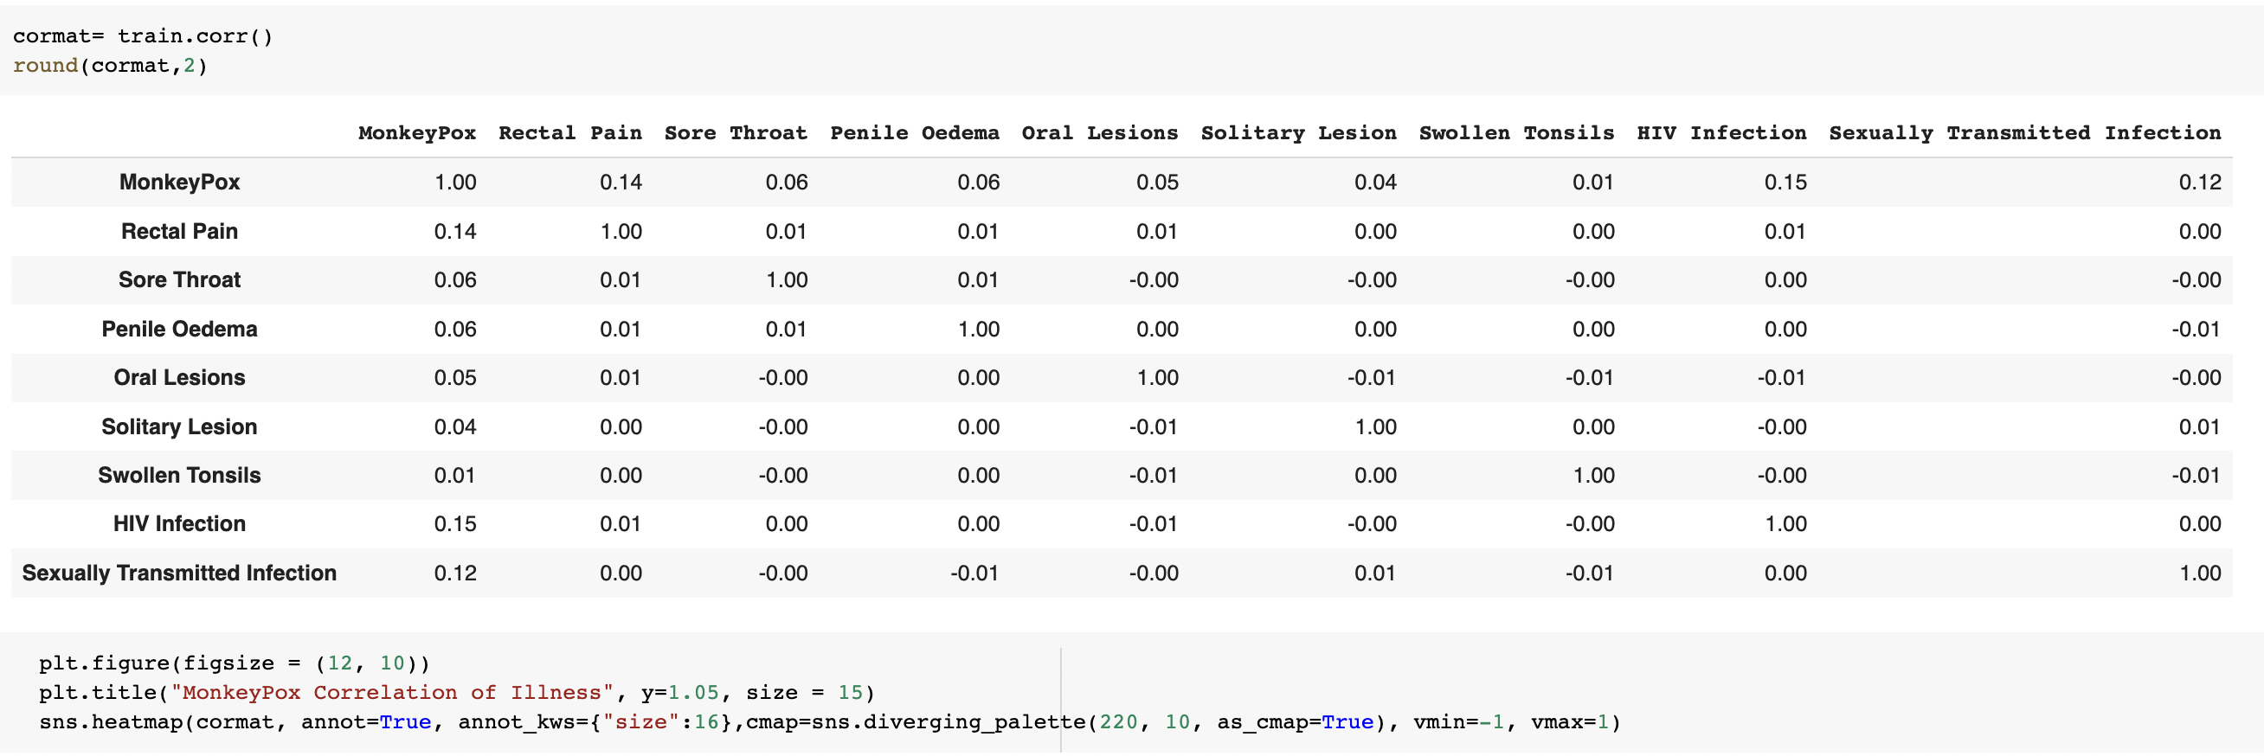
Correlation Table

Slide 20
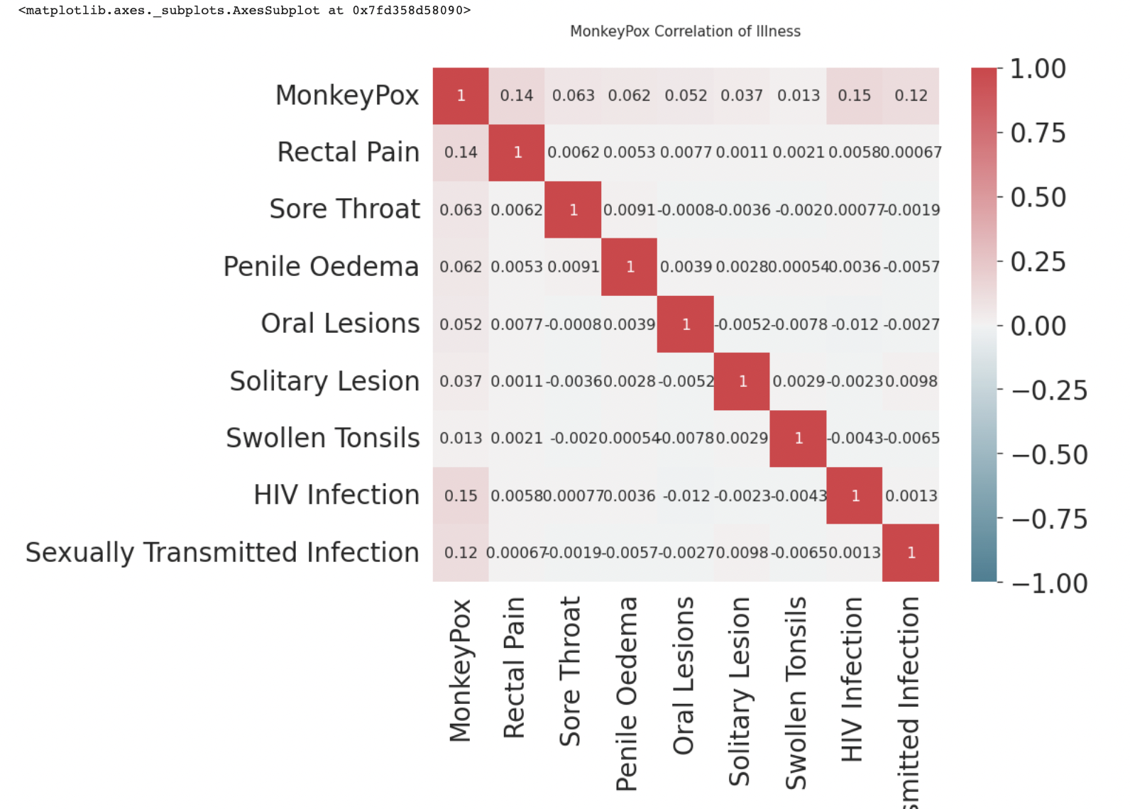
Correlation Heat Map

Slide 21
06. Logistic
Regression

Slide 22
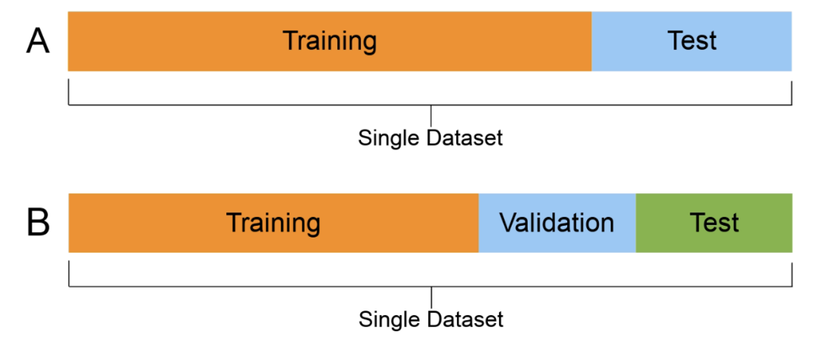
Splitting the Data

Slide 23
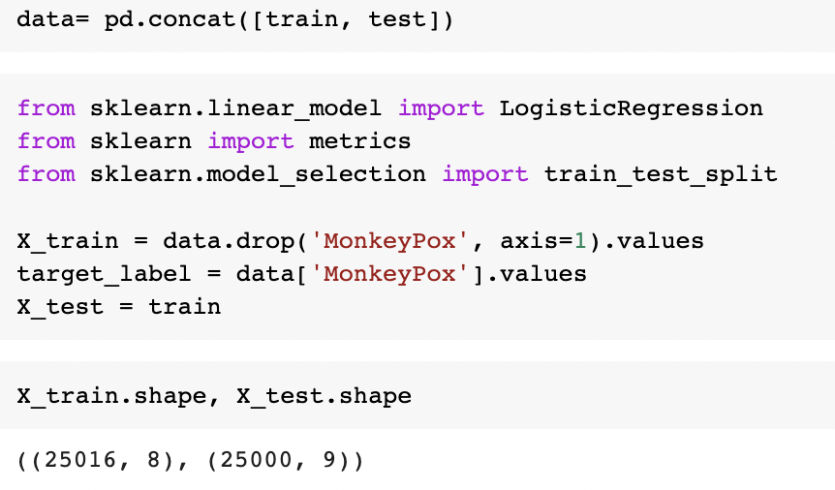
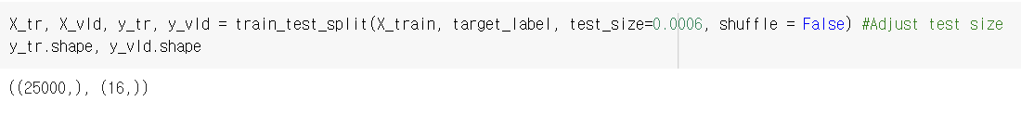
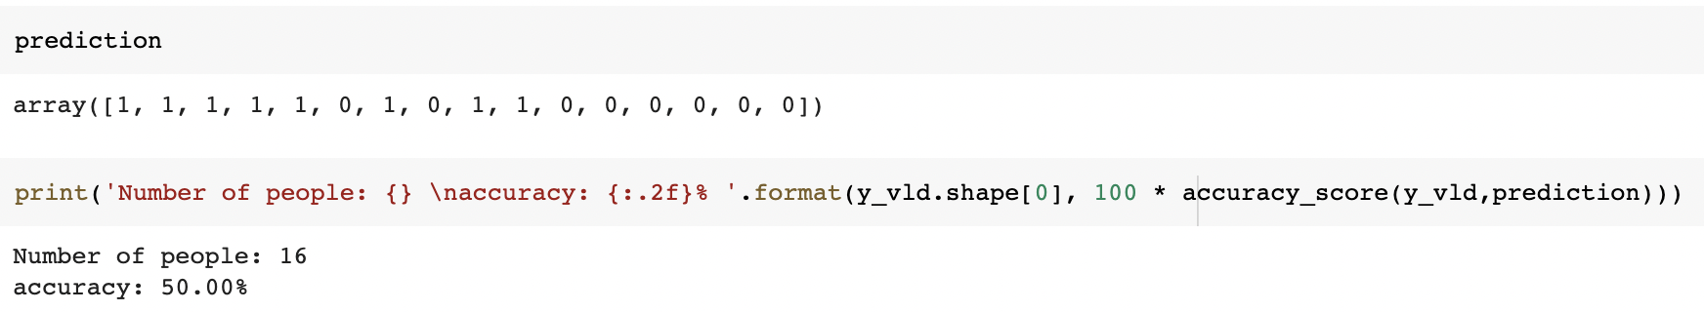
Creating Regression Model
Splitting
Formula

Slide 24
Regression Model Result
 | Name | Prediction Result
1 | Juhui Yun | Positive
2 | Bhavya | Positive
3 | Kiyun Oh | Positive
4 | Daniel Nguyen | Positive
5 | Chris Guo | Positive
6 | Clara | Negative
7 | Drake | Positive
8 | Kevin Wu | Negative
9 | Alleen | Positive
10 | Jason | Positive
11 | Jasmine | Negative
12 | Bob | Negative
13 | Johnny Lee | Negative
14 | Nandini | Negative
15 | Aaron | Negative
16 | Seungeun Yi | Negative
Actual Result
Negative
8 Negative
8 Positive
50% Accuracy

Slide 25
Wrap Up

Slide 26
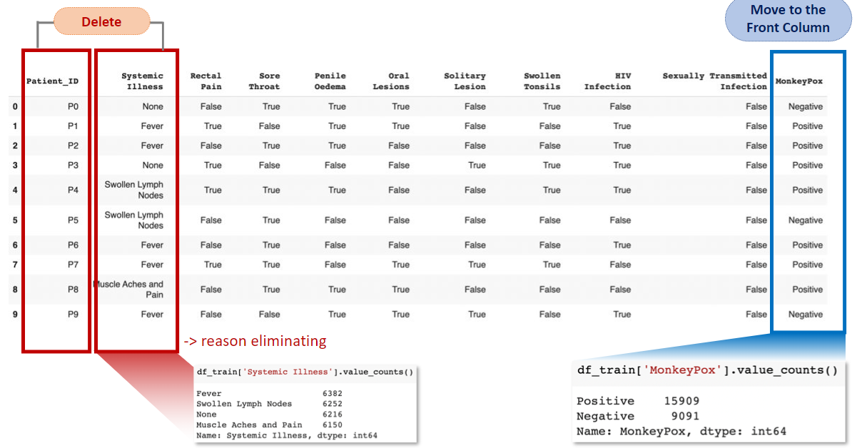
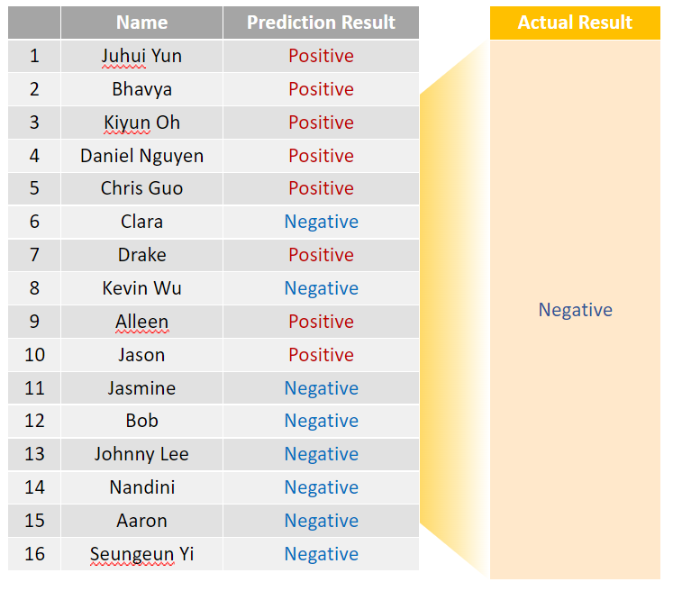
Process Overview
Data Visualization
Data Cleansing
Correlation Plot
Logistic Regression

